Slide 1
Early Explorers

Slide 2
Marco Polo
Sailed to China in 1250
Marco!?! Polo!!

Slide 3
Christopher Columbus
Sponsored by Spain’s King and Queen
Columbus sailed the ocean blue in 1492
Thought he was in India

Slide 4
Cabot
Found Canada
Ca & Ca

Slide 5
Amerigo Vespucci
Explored east coast of S. America
The Americas name sake

Slide 6
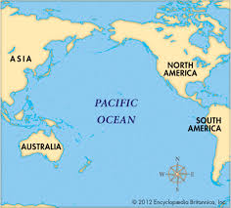
Balboa
First explorer to see the Pacific Ocean

Slide 7
Magellen
First to try to sail completely around the world
Never made it
https://www.youtube.com/watch?v=pM-igYjn6E4

Slide 8
Ponce de Leon
Looked for the “Fountain of Youth”
Pounced like a lion for fountain

Slide 9
Cortés
Looked for gold in Mexico
Found the Aztecs

Slide 10
Coronado
Searched for the “Seven Cities of Gold”

Slide 11
Pizarro
Was Spanish conquistador
Explored western coast of S. America
Took Incan Empire

Slide 12
De Soto
1st explorer to see Mississippi
Minnesota – De Soto

Slide 13
Verrazano
Sailed for France
Looked for NW Passage along Atlantic coast

Slide 14
Cartier
Found St. Lawrence River & claimed it for Canada

Slide 15
Hudson
Explored river in NY
Hudson River
Claimed land for Dutch

Slide 16
Kahoot
https://play.kahoot.it/#/?quizId=1264f8c2-d355-4d72-9655-1028ef688cf3

